Slide 1
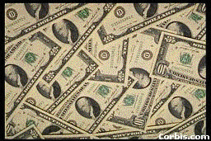
CASH AND TRASH
CASH AND TRASH

Slide 2
Experiences of a university professor at Ludhiana
I contribute regularly for gurdwara functions.
Once, special Gurpurb celebrations were arranged by the campus residents of the University.
The organizers as usual visited me for my contributions.
I usually gave 25 rupees every time they came for collections. They told me, “This will be a special function, we want bigger contributions this time. Mr. A (a clerk) paid 20 rupees.”

Slide 3
.” This was a signal for me to double my contributions. However, keeping my recent promotion and position at the University in mind,
I contributed one hundred rupees. The members were very pleased since they expected only 50 rupees.

Slide 4
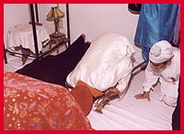
When my friends left, my ego overtook me, “Look! I am a great Sikh.
This contribution will draw God’s attention and He will give me special rewards for this.”
When I went through the aisle to pay my respect to Guru Granth Sahib, I could not help looking at the Sangat already sitting there.

Slide 5
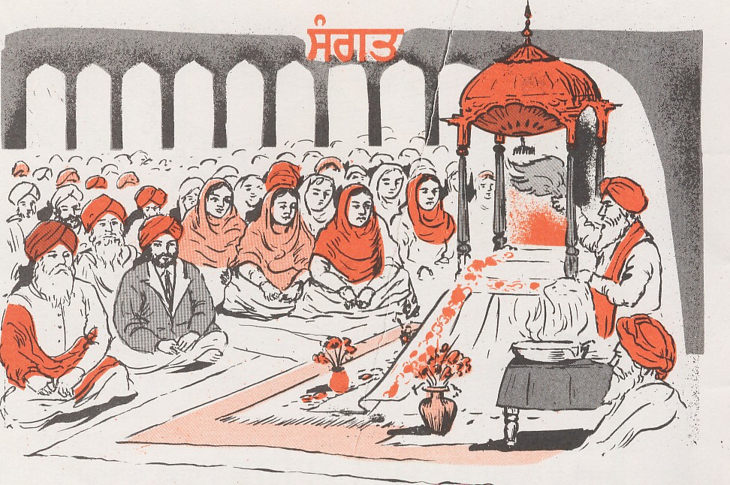
Drenched in my ego, I said to myself, “This person would have paid only five rupees; this teacher might have given ten rupees; this worker would not have paid anything, he has come only for langar.
Look! I paid one hundred rupees. I am really a great devotee.”

Slide 6

The dialogue with God’s office
This thinking continued in my mind even after the function was over and I had returned to my house.
At night I had a dream in which I telephoned God.
The dialogue, which I had with His office, was like this:
: God’s office. What can we do for you?
Professor: Do you know that I gave one hundred rupees for the Gurpurb? Did you credit this big money to my accounts?

Slide 7

Response: No. We received no money from you.
Professor: How could you miss this big sum of money? I may be the only devotee to give that big an amount.
Response: Oh! Yes, I now remember. We received the cash but threw it in the trash for where it was meant.
You gave the money to build your ego and not with love for God. There is no place for ego here.
So far as your account with us is concerned, it is totally blank.

Slide 8

I was really disappointed to hear that.
I could not help crying like a child (in my dream).
The office secretary became concerned with my weeping.
To console me she said, “Let me check with the other secretary,
she maintains another kind of account. I am going to connect you with that desk, please continue to hold.

Slide 9

I was very happy when the second secretary told me that I have a huge balance in my favor and will never feel any shortage of anything, anywhere.
I could not believe my ears when I heard about the huge balance in my credit.
I asked her when had I deposited that money?
I heard the secretary speaking, “A couple of months back in the month of November, you had an argument with your wife.

Slide 10

She was proud of your promotion at becoming the head of the department, and therefore had purchased new shoes for your son.
You didn’t approve of the purchase because the old shoes were in good shape.
When you questioned her she replied that she didn’t want her son to get sick in the cold wearing old shoes.
You were upset and left the house for your office.

Slide 11

When you got out of the house, you saw some poor students going to their primary school.
One of them was without shoes.
Your heart was moved with sympathy for the boy going to school barefoot.
You told the boy to wait there. You went inside, picked up those old shoes and gave them to the boy.
The boy put on the shoes, smiled a little and without saying anything walked away to his school.

Slide 12
The sympathy for the poor has turned the trash (old shoes) into an unlimited amount of cash and you will never be short of anything.
Do you remember this?”
She hung up even before I could say, “thank you.”

Slide 13
“Ego turns our cash into trash.
Dear friend, I know you practice a religious life and that is why I have shared my dream with you.
It has given me a great lesson,
“Ego turns our cash into trash.
Sympathetic feeling for the poor turns trash into cash.

